Slide 1
Discrete Mathematics: Lecture 26 Part IV. Graph Theory Hamilton Paths and Circuits, Shortest Paths and Djikstra’s Algorithm, Traveling Salesperson Problem, Planar Graph, Euler’s Formula
Xuming He
Associate Professor
School of Information Science and Technology
ShanghaiTech University
Spring Semester, 2024
Notes by Prof. Liangfeng Zhang

Slide 2
Review: Euler Paths and Circuits
DEFINITION: Let $G=(V,E)$ be a graph.
Euler Path欧拉路径: a simple path that traverses every edge of $G$.
Euler Circuit欧拉回路: a simple circuit that traverses every edge of $G$.

Slide 3
Review: Construction
ALGORITHM (Hierholzer):
Input: $G=\left(V,E\right),$ a connected multigraph, $2|\deg\left(x\right), ∀x∈V$
Output: an Euler circuit
$circuit:=a circuit in G$
$H:=G−circuit−isolated vertices$
$while H has edges do$
$subcircuit:=a circuit in H that intersects circuit$
$H:=H−subcircuit−isolated vertices$
$circuit:=circuit∪ subcircuit$
$return$ $circuit$

Slide 4
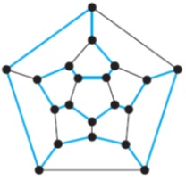
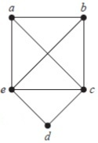
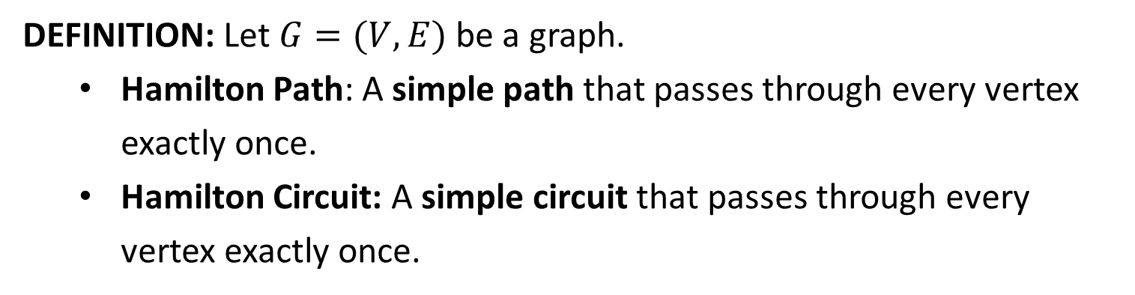
Hamilton Paths and Circuits
DEFINITION: Let $G=(V,E)$ be a graph.
Hamilton Path: A simple path that passes through every vertex exactly once.
Hamilton Circuit: A simple circuit that passes through every vertex exactly once.
√ Hamilton path
√ Hamilton circuit
√ Hamilton path
√ Hamilton circuit
√ Hamilton path
$×$Hamilton circuit
$×$ Hamilton path
$×$Hamilton circuit

Slide 5
Hamilton Circuits
Determine if there is a Hamilton circuit in a given graph $G$?
This problem is NP-Complete. //that means very difficult
Necessary conditions on Hamilton circuit.
If $G$ has a vertex of degree 1, then $G$ cannot have a Hamilton circuit.
If $G$ has a vertex of degree 2, then a Hamilton circuit of $G$ traverses both edges.
Sufficient conditions on Hamilton circuit.
Ore’s Theorem: Let $G=(V,E)$ be a simple graph of order $n≥3$. If $\deg\left(u\right)+\deg\left(v\right)≥n$ for all $\left\{u,v\right\}∉E$, then $G$ has a Hamilton circuit.
Dirac’s Theorem: Let $G=(V,E)$ be a simple graph of order $n≥3.$ If $\deg\left(u\right)≥n/2$ for every $u∈V$, then $G$ has a Hamilton circuit.
This is a corollary of Ore’s Theorem
$∀u∈V, \deg\left(u\right)≥n/2⇒∀u,v∈V,\deg\left(u\right)+\deg\left(v\right)≥n$

Slide 6
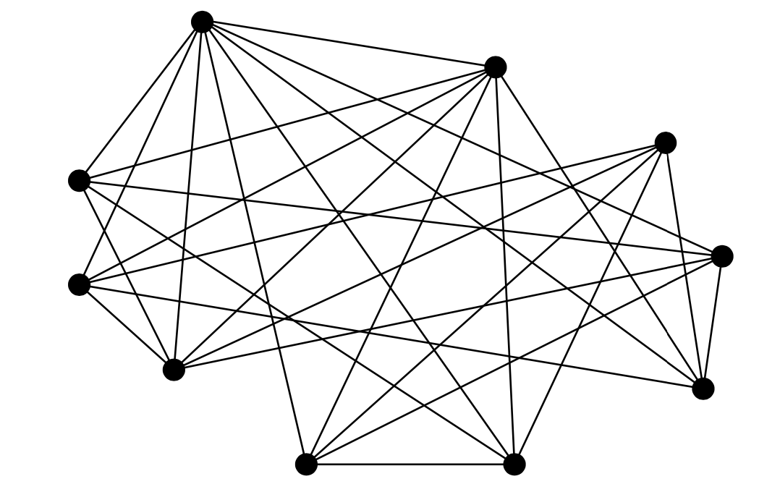
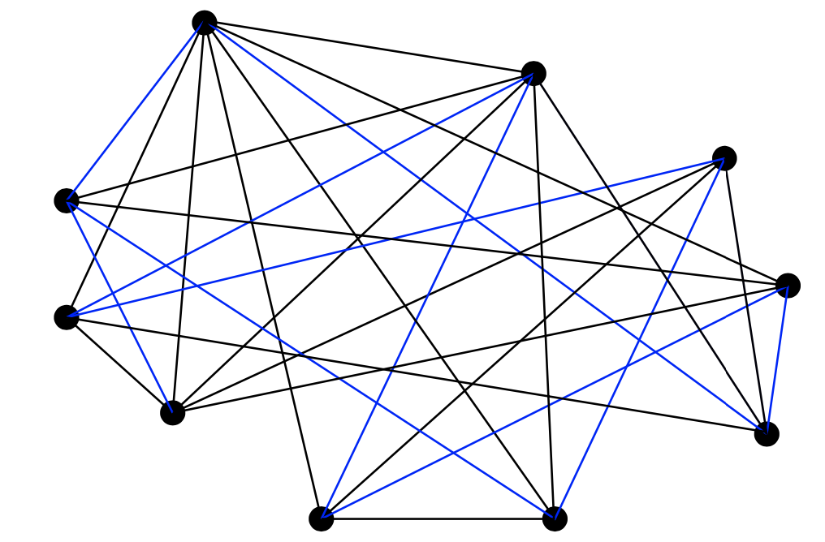
Hamilton Circuits
Examples (sufficient condition)

Slide 7
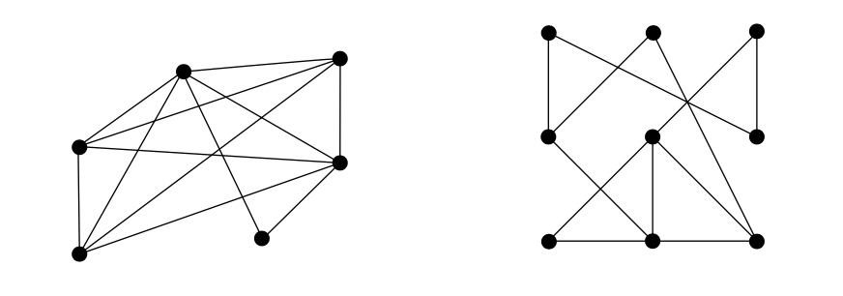
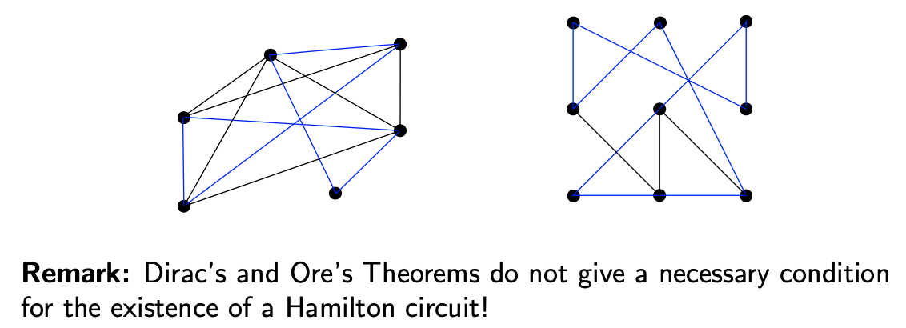
Hamilton Circuits

Slide 8
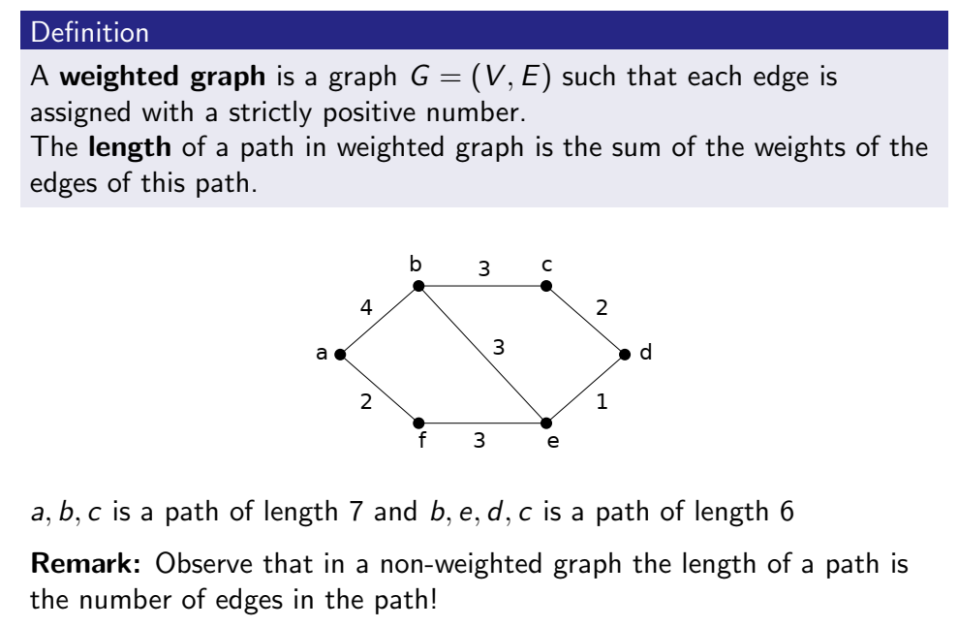
Shortest Path Problem

Slide 9
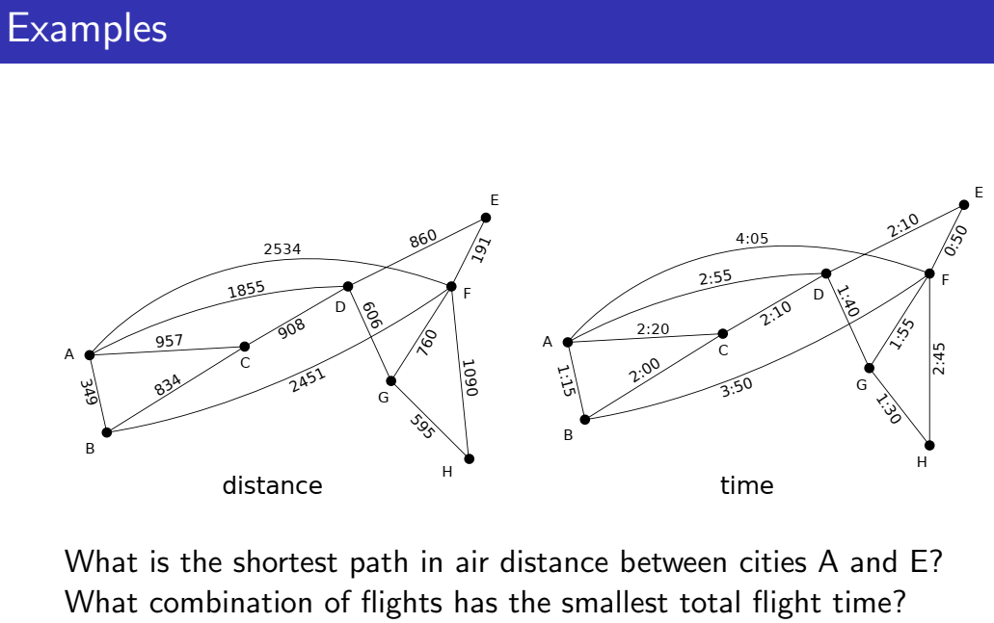
Shortest Path Problem

Slide 10
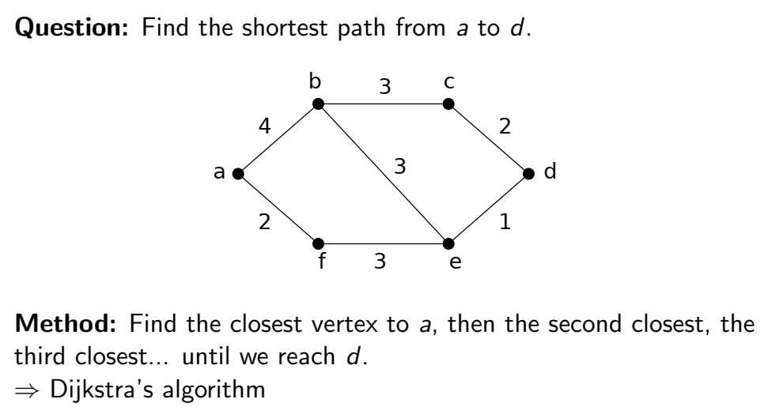
Shortest Path Problem

Slide 11
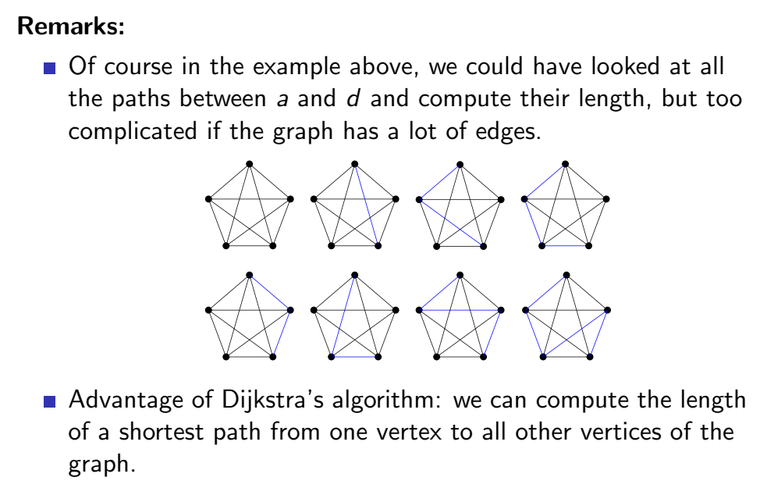
Shortest Path Problem

Slide 12
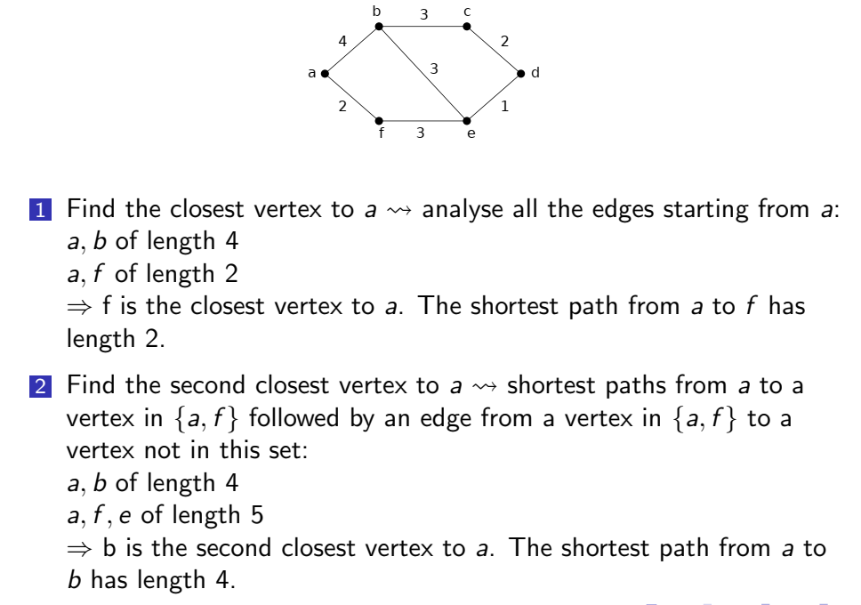
Djikstra’s Algorithm

Slide 13
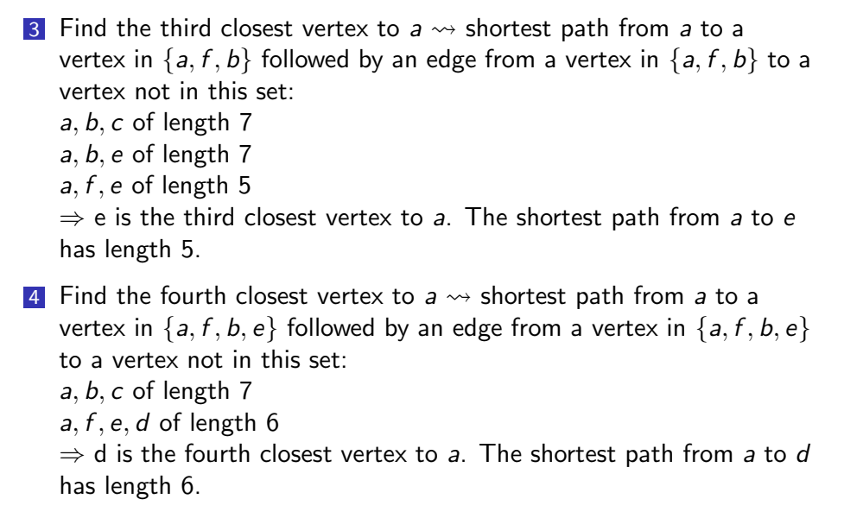
Djikstra’s Algorithm

Slide 14
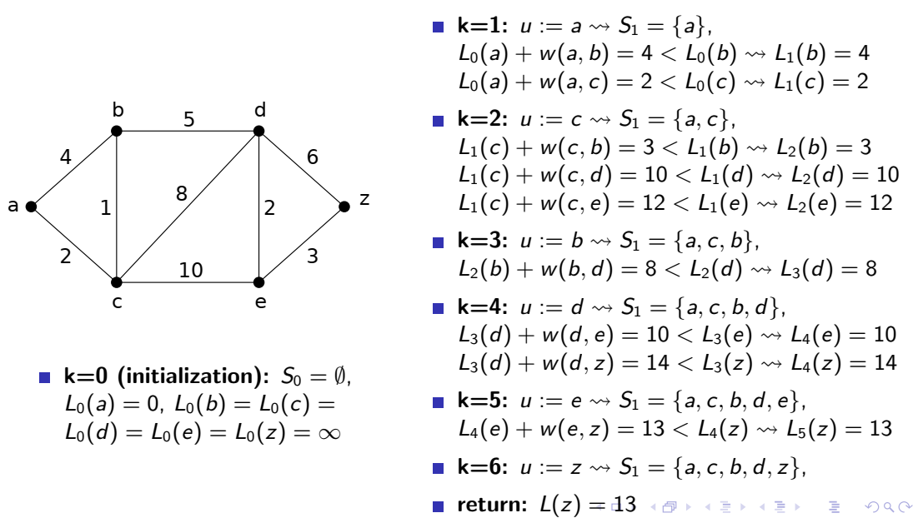
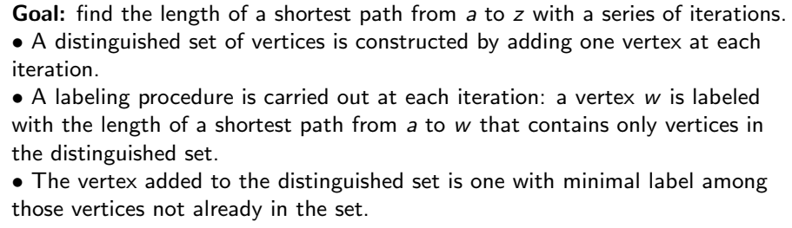
Djikstra’s Algorithm

Slide 15
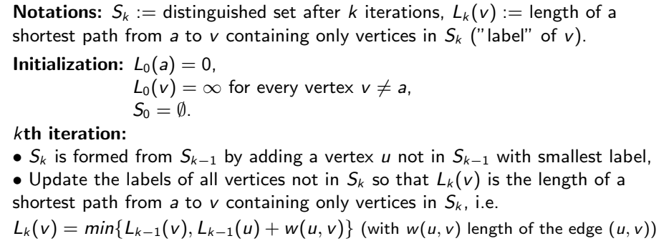
Djikstra’s Algorithm

Slide 16

Djikstra’s Algorithm
$$2$$
$$3$$
4
5
$$6$$
$$\left\{a,c,b,d,e,z\right\}$$

Slide 17
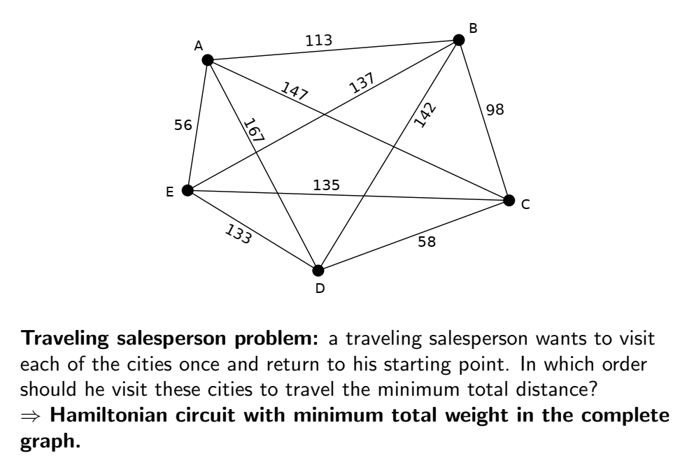
Traveling Salesperson Problem

Slide 18
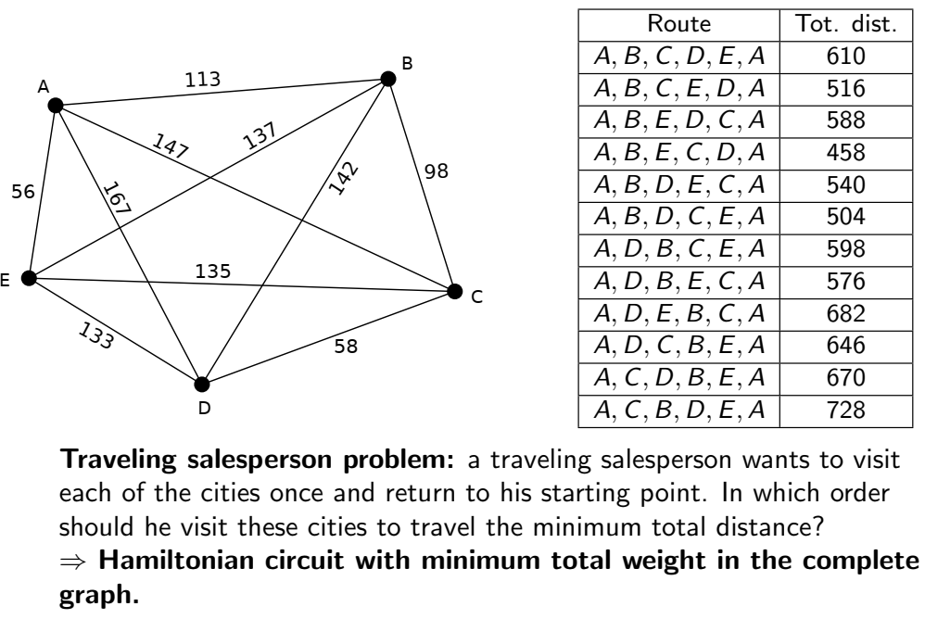
Traveling Salesperson Problem

Slide 19
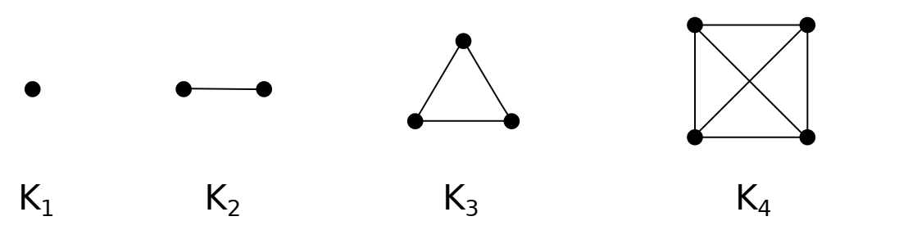
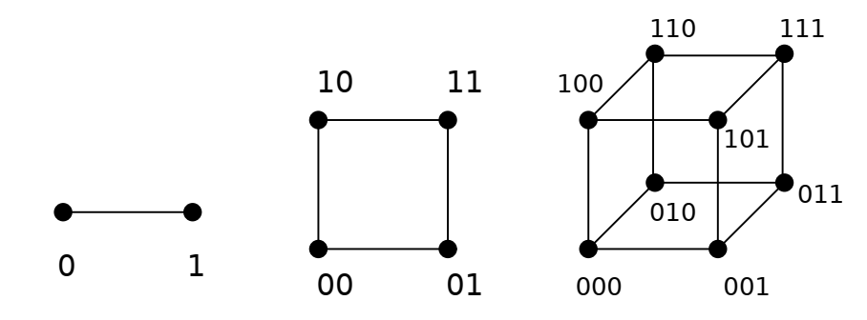
Planar Graph
DEFINITION: Let $G=(V,E)$ be an undirected graph. $G$ is called a planar
graph平面图 if it can be drawn in the plane without any edges crossing.
Crossing of edges: an intersection other than endpoints (vertices)
planar representation平面表示: a drawing w/o edge crossing; nonplanar非平面的
$K_{1}, K_{2},K_{3}, K_{4}$ are planar graphs
$K_{1,n}, K_{2,n}$ are planar graphs
$C_{n} (n≥3), W_{n}(n≥3)$ are planar graphs
$Q_{1},Q_{2},Q_{3}$ are planar graphs

Slide 20
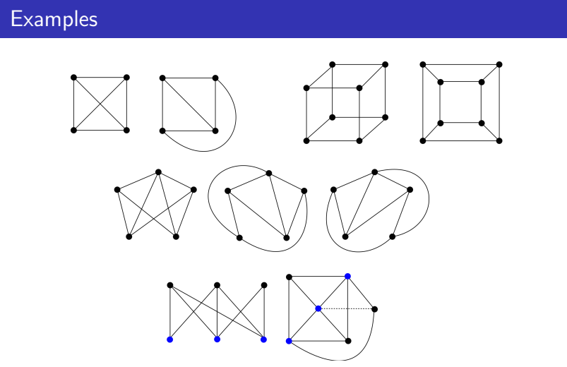
Planar Graph
A graph may be planar even if it is usually drawn with crossings, because it may be possible to draw it in a different way without crossings.

Slide 21
Nonplanar Graph
Jordan Curve Theorem: Every simple closed planar curve $Γ$ separates
the plane into a bounded interior region and an unbounded exterior
region. Any planar curve connecting the two regions must intersect $Γ.$
EXAMPLE: The bipartite graph $K_{3,3}$ is not planar.
choose a simple circuit $v_{1},v_{5},v_{2},v_{4},v_{1}$ in $K_{3,3}$
If $K_{3,3}$ is a planar, then the circuit forms a simple closed planar curve
Add $v_{3},v_{6}$ and the edges incident with them.
Intersection occurs (due to the Jordan curve Theorem).

Slide 22
Nonplanar Graph
EXAMPLE: The complete graph $K_{5}$ is not planar.
$v_{1},v_{2},v_{3},v_{4},v_{5},v_{1}$ is a simple closed curve in the planar representation of $K_{5}$
Every remaining edge is in the interior region or in the exterior region
at least one is in the interior region
No matter how you draw the remaining edges, crossing occurs.

Slide 23


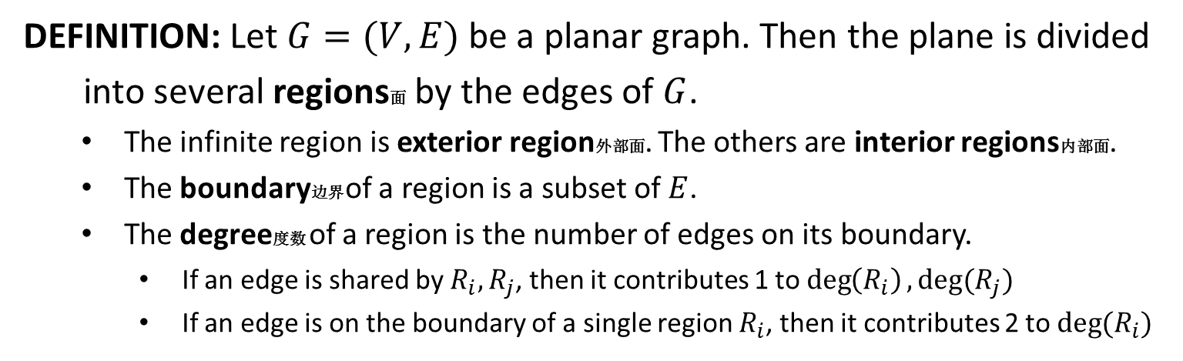







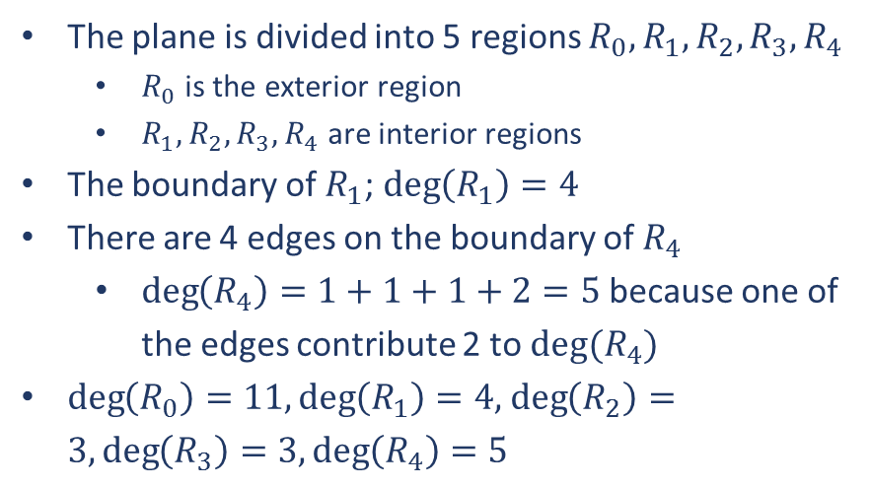
Regions
DEFINITION: Let $G=(V,E)$ be a planar graph. Then the plane is divided
into several regions面 by the edges of $G$.
The infinite region is exterior region外部面. The others are interior regions内部面.
The boundary边界 of a region is a subset of $E$.
The degree度数 of a region is the number of edges on its boundary.
If an edge is shared by $R_{i},R_{j}$, then it contributes 1 to $\deg\left(R_{i}\right), deg(R_{j})$
If an edge is on the boundary of a single region $R_{i}$, then it contributes 2 to $deg⁡(R_{i})$
$$a$$
$$b$$
The plane is divided into 5 regions $R_{0},R_{1},R_{2},R_{3},R_{4}$
$R_{0}$ is the exterior region
$R_{1},R_{2},R_{3},R_{4}$ are interior regions
The boundary of $R_{1}$; $\deg\left(R_{1}\right)=4$
There are 4 edges on the boundary of $R_{4}$
$\deg\left(R_{4}\right)=1+1+1+2=5$ because one of the edges contribute 2 to $deg⁡(R_{4})$
$\deg\left(R_{0}\right)=11,\deg\left(R_{1}\right)=4,$ $\deg\left(R_{2}\right)=3, \deg\left(R_{3}\right)=3, \deg\left(R_{4}\right)=5$
$$R_{1}$$
$$d$$
$$c$$
$$R_{2}$$
$$R_{4}$$
$$R_{3}$$
$$R_{0}$$

